Slide 1
Sharing a lane during covid-19
Bainbridge island aquatic center

Slide 2
Changes in November 2020
Nakata Pool
Individuals assigned spots 1 and 17 will share lane 1.
Individuals assigned spots 3 and 15 will share lane 3.
IN November, we are under new guidance from our Washington state department of health that permits 2 lap swimmers to share a lane.
Lane 1
Lane 3

Slide 3
Staying on your side of the lane
Swimmer 17
Your side is the on the right when facing the water
During this time, please do not circle swim
Please start, stop and rest at your designated spot (where you entered the water)
When water walking in a lane, please maintain social distancing with your lane mate except when briefly passing
Swimmer 1

Slide 4
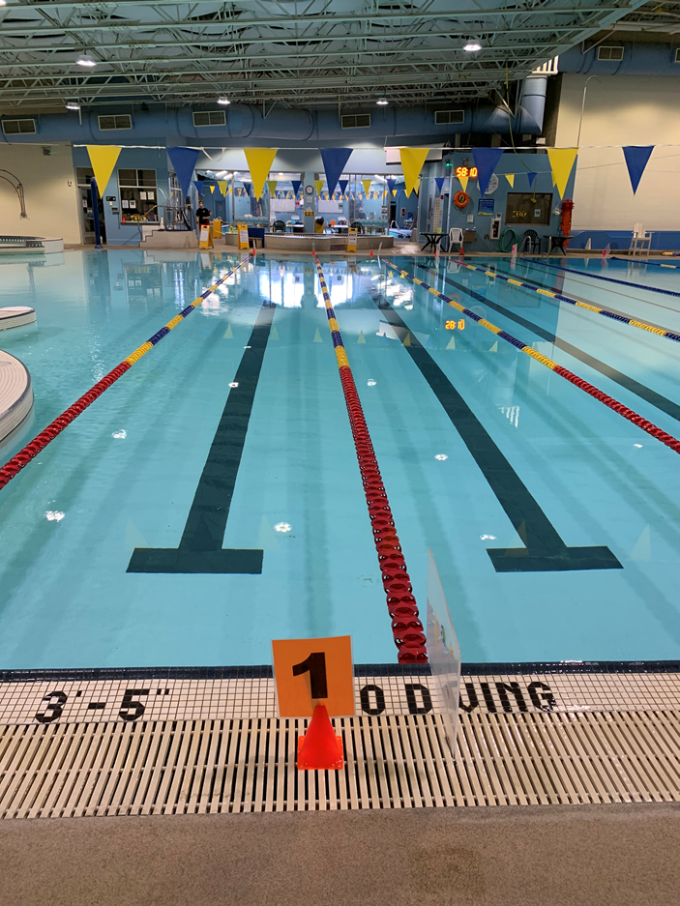
What if someone is exercising at the wall or taking a break?
Stationary workout at wall or resting, please face the wall if possible.
When someone is resting or stopped at their designated wall, please stop prior to reaching the wall, turn around, and continue your swim.

Slide 5
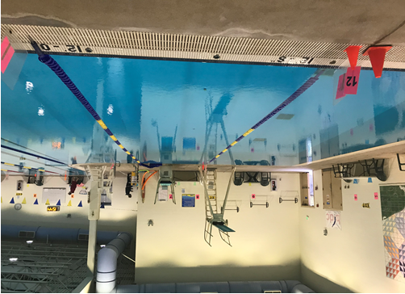
Water Exercise Class layout
–
7
6
5
10
8
11
12
13

